Slide 1
Brand Equity Components I: Brand Awareness

Slide 2
Overview
Consumer-based model of brand equity
Brand logo quiz
Brand awareness and recognition
Value of brand awareness
Creating strong brand awareness

Slide 3
Sources of Brand Equity
Perceived
Quality
Brand
Associations
Name
Awareness
Brand Equity
Name
Symbol
Other Proprietary
Brand Assets
Brand
Loyalty

Slide 4

ABCs of Branding

Slide 5
ABCs of Branding (2)

Slide 6
The Brand Awareness Pyramid
Top of
Mind
Brand Recall
Brand Recognition
Unaware of Brand

Slide 7
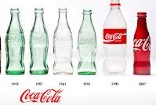
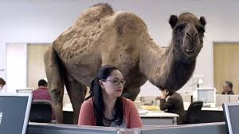
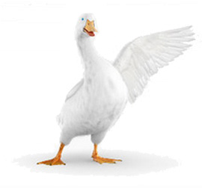
Creating Brand Awareness
Brand uniqueness
Consistent promotion
Strong symbol/slogan
Repetition!
BRAND AWARENESS

Slide 8
The Value of Brand Awareness
Consideration Set
In-Store Recognition
Incidental Exposure
BRAND AWARENESS

Slide 9
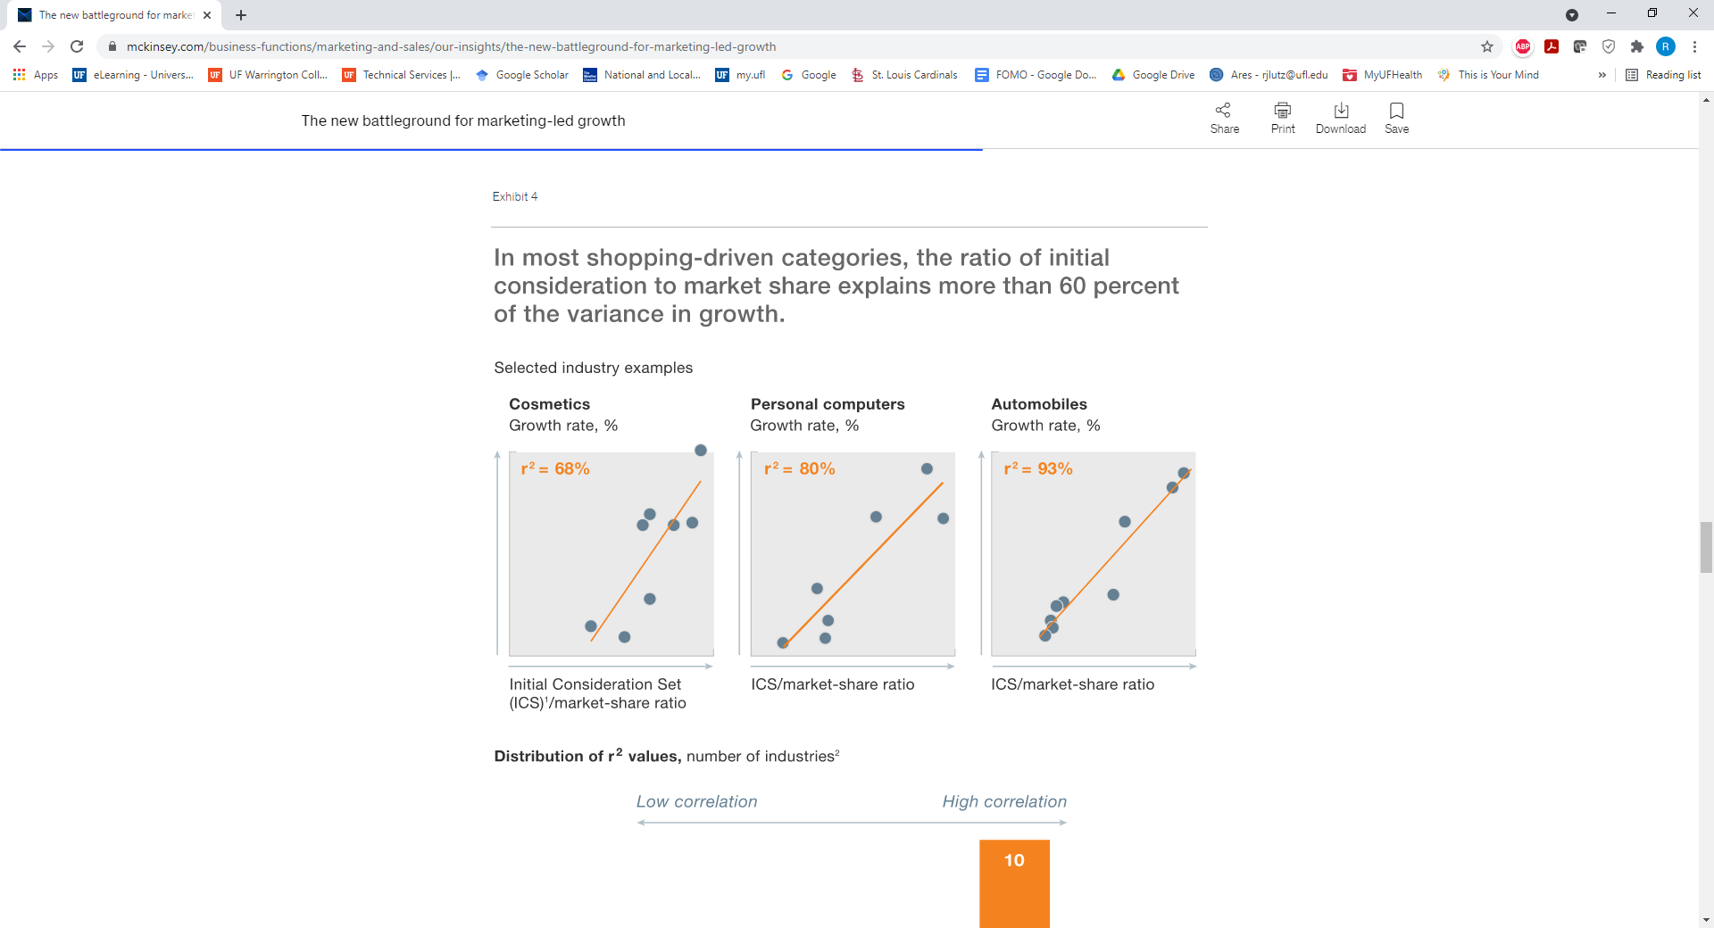
Consideration Set and Market Share

Slide 10
Conclusion
When you think of your personal favorite brands, are they well-known or relatively obscure?
Is your organization’s brand well-known in its target market?

Slide 11
End of Lecture

